Slide 1


Slide 2
BATTLE OF CRIMINALS
Supervisor:
Mr. Rehan Tariq
Group Member:
Muhammad Zeeshan(SP17-BCS-028)
Ali Raza (SP17-BCS-003)
Program:
BS-Computer Science

Slide 3
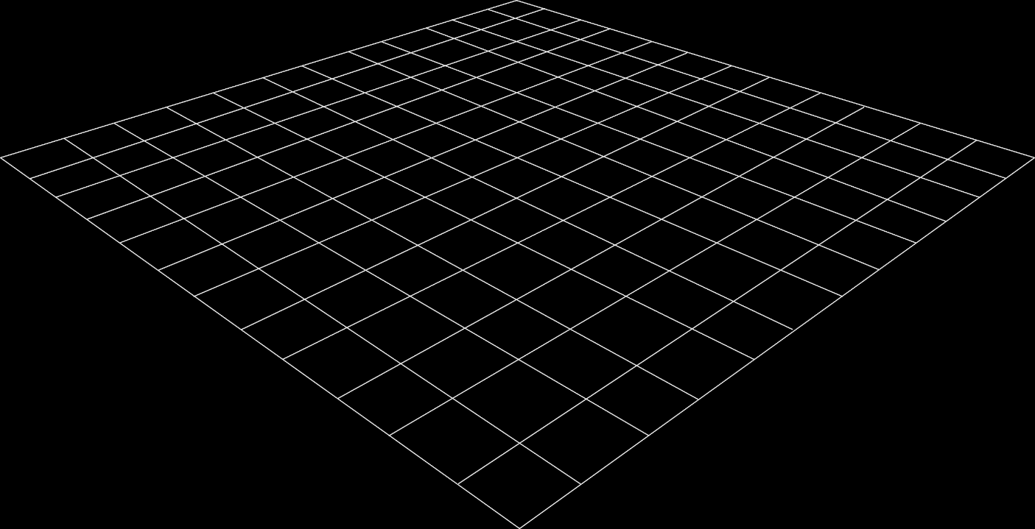
Introduction
A Battle Royale Game
Limited Individual players
Individuals will fight against each others, no duo, squad concept
Last standing player gameplay

Slide 4
Problem Statement
Old concept of games
Repetitive Ideas
Small maps
Single player/offline games

Slide 5
Methodology
All players start with no Equipment, and they will have to find weapons, ammo, equipment to survive.
The equipment that will be used for combat, survival or transport is randomly scattered around the map, often at landmarks or
within buildings.
Player need to search for these items while avoid being killed by other players.
Players will fight against each other as well as the players will fight AI bots and bores also.

Slide 6
Goals and Objectives
Following are our objectives and goals behind this project, which are enlisted below.
Learning complete functionality of shooting games
In-depth knowledge of multiplayers, and how they get into rooms and game
Backend database working behind the game
Modelling and designing of the game environment.

Slide 7
Benefits
Entertainment
Skills Showcasing
Learned a lot about the multiplayer games.
Networking knowledge
Promoting students towards game industry

Slide 8
Tools & Techniques
Relation | Tools
User Interface & Development | Unity 3D
3D Modeling | Maya
Animation | Mixamo
Database | PlayFab
Programming Language | C#
Server Management | Photon Unity Networking (PUN)

Slide 9
Functional Requirements
Requirements are important part of software development. Before starting a project, requirements are gathered, to formulate and manage the designing phase.
Server Making
Making a server is essential part of project. For that purpose, photon unity networking has been used for server/room creation.
AI Bots
When there will be insufficient players to join the server, AI Bots will be instantiated to full up the space.
Player Movement
Complete player movement, jump run in all aspects.

Slide 10
Non-Functional Requirements
Non-Functional requirement defines a function and its components.
Performance
We are trying to achieve best performance for our game, but this project involves too much graphics, so it would affect efficiency.
Availability
Users can access the system anytime, anywhere.
User friendly
Interface of our game will be easy to use so that a beginner can also play it.

Slide 11
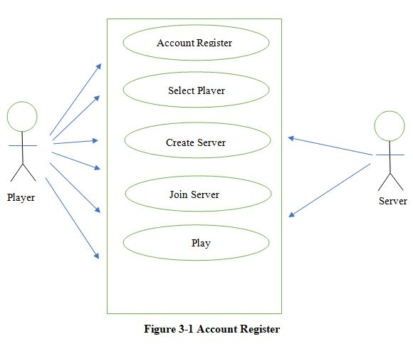
Use Case Diagram

Slide 12
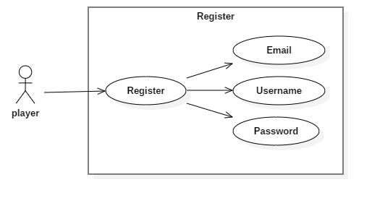
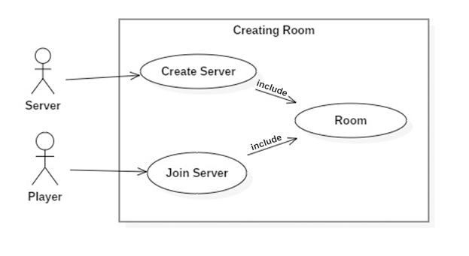
Detailed Use Case Diagrams

Slide 13
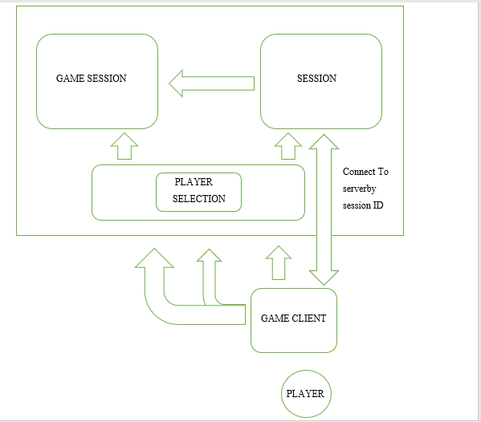
Class Diagram

Slide 14
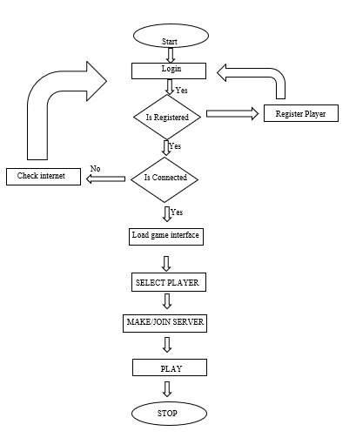
Data Flow Diagram

Slide 15
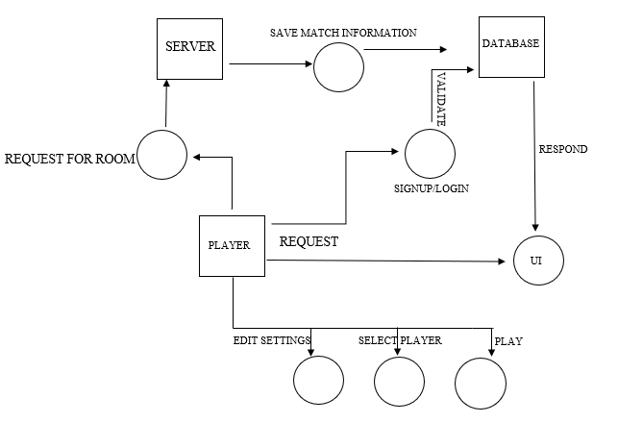
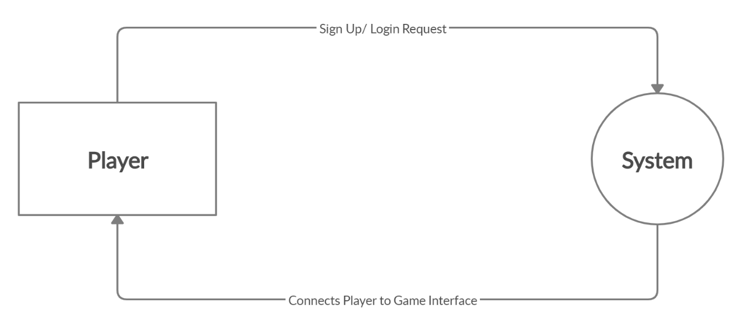
Data Representation

Slide 16
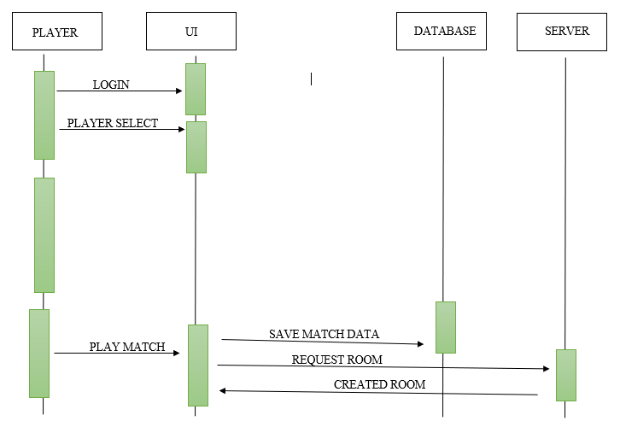
Sequence Diagram

Slide 17
External APIs
Photon Unity Networking
Photon Unity Network (PUN) is a Unity software package for multiplayer games. Flexible matching allows your players to enter the room and play together smoothly.
PlayFab
PlayFab is a backend (database) service for real-time (multiplayer) games, with hosted game services, real-time analysis and takes care of players data. While reducing costs, increase revenue and increase player engagement.

Slide 18
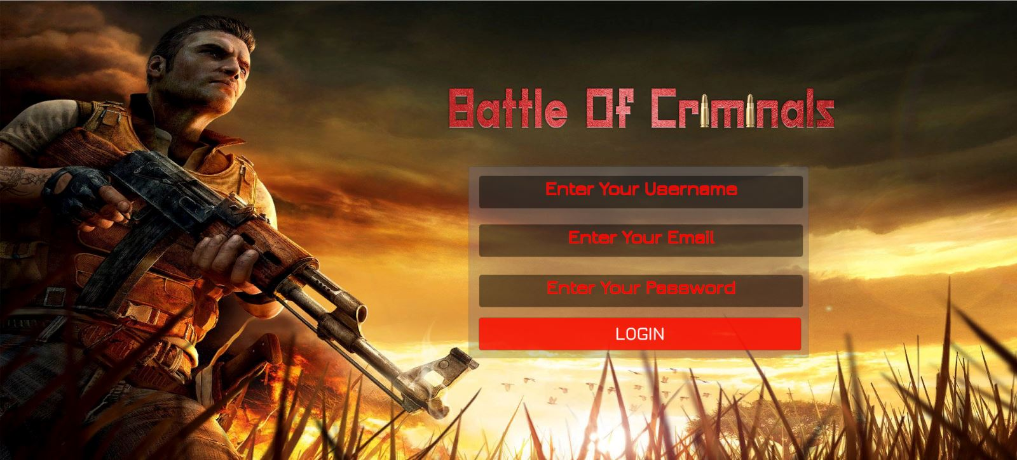
User Interface
Login/Register
Username | User will enter a unique username.
Email | User should enter a valid Email
Password | User needs to enter a password. Password should be 6 Characters long

Slide 19
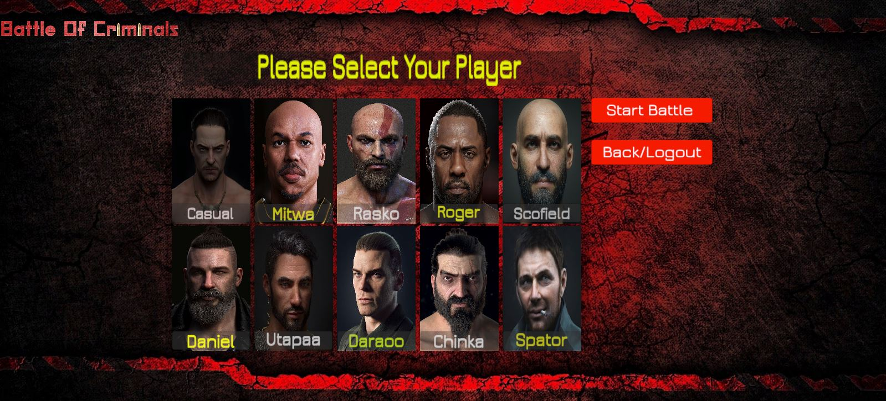
User Interface
Main Menu/Lobby
Start | Create room or check for available room and start the match
Cancel | Cancel matchmaking and player leaves room
Connected | Display connection status. Whether the player is connected to sever or not

Slide 20
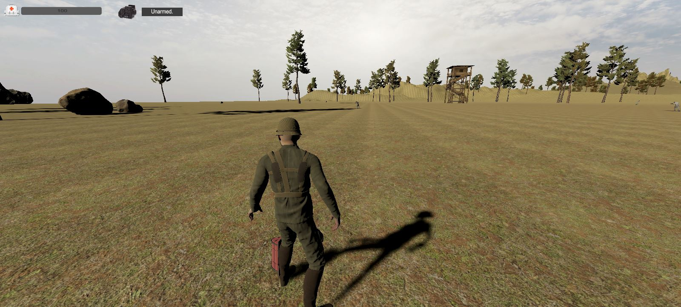
User Interface
In Game UI
Mask | Displays map camera view
Username | Displays Username
Ammo | Displays current ammo in magazine, as well as remaining total ammo.
Items | Displays total number of grenades, smoke, and medkits
Weapons | Display the current weapon picked by player
Health Bar | Displays player current health

Slide 21
Manual Testing
Phase to test | Test Description | Expected Results | Actual Results
Server Connection | Player needs to have Internet connection to connect to photon server, otherwise he will be unable to play | User will connect to photon server and create room, and other players will join | Pass
Room Creation | Start button should be used for creating and joining rooms | When player click Start button, game will check for available room, if room is available then player will join that room otherwise new room will be created | Pass
Ammo Update | Ammo text should update when ammo is picked up by player as well as when player shoot | When player pick ammo then total ammo will be updated, and when he shoots or reload, current will be updated | Pass
Health Bar | Health of player should be decrease when opponent fires at our player | Health will decrease according to the damage value of opponent value | Pass
Unit Testing

Slide 22
Manual Testing
Functional Testing
Phase to test | Test Description | Expected Results | Actual Results
PUN (Photon Unity Networking) | Check internet connection and player connecting to server | Send request to photon Server, check App-ID and connects player to photon server | Pass
PlayFab | Connects user by checking App ID and check data provided by user to Login | Send request to PlayFab Server to check user’s provided credentials and successfully sign in player | Pass

Slide 23
Future Work
We have found out few limitations in Unity Engine, during development of this project so we have decided to remake this Project in Unreal Engine in future.
We will improve player and Bot animation.
AI Bots are working fine but sometimes, they get stuck. So Artificial Intelligence of Bots will be improved in future.
We will add Simple Chat and Voice chat system into the game.
New maps will be added.
New Weapons will be added.

